Slide 1

Midcurve by Neural Networks
Yogesh Kulkarni

Slide 2
MidcurveNN : Encoder-Decoder Neural Network for Computing Midcurve of a Thin Polygon

Slide 3
Introduction

Slide 4
Strength Analysis by CAE
Aerospace
Machinery
Consumer Products
Industrial equipment
Energy
Construction

Slide 5
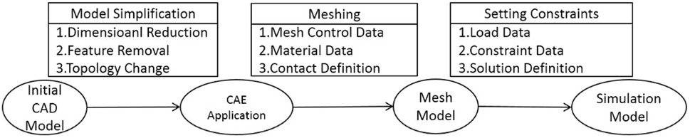
Can we use shapes directly?
CAD : Designing Shapes
CAE : Engineering Analysis
CAD->CAE: Simplification for quicker results.

Slide 6
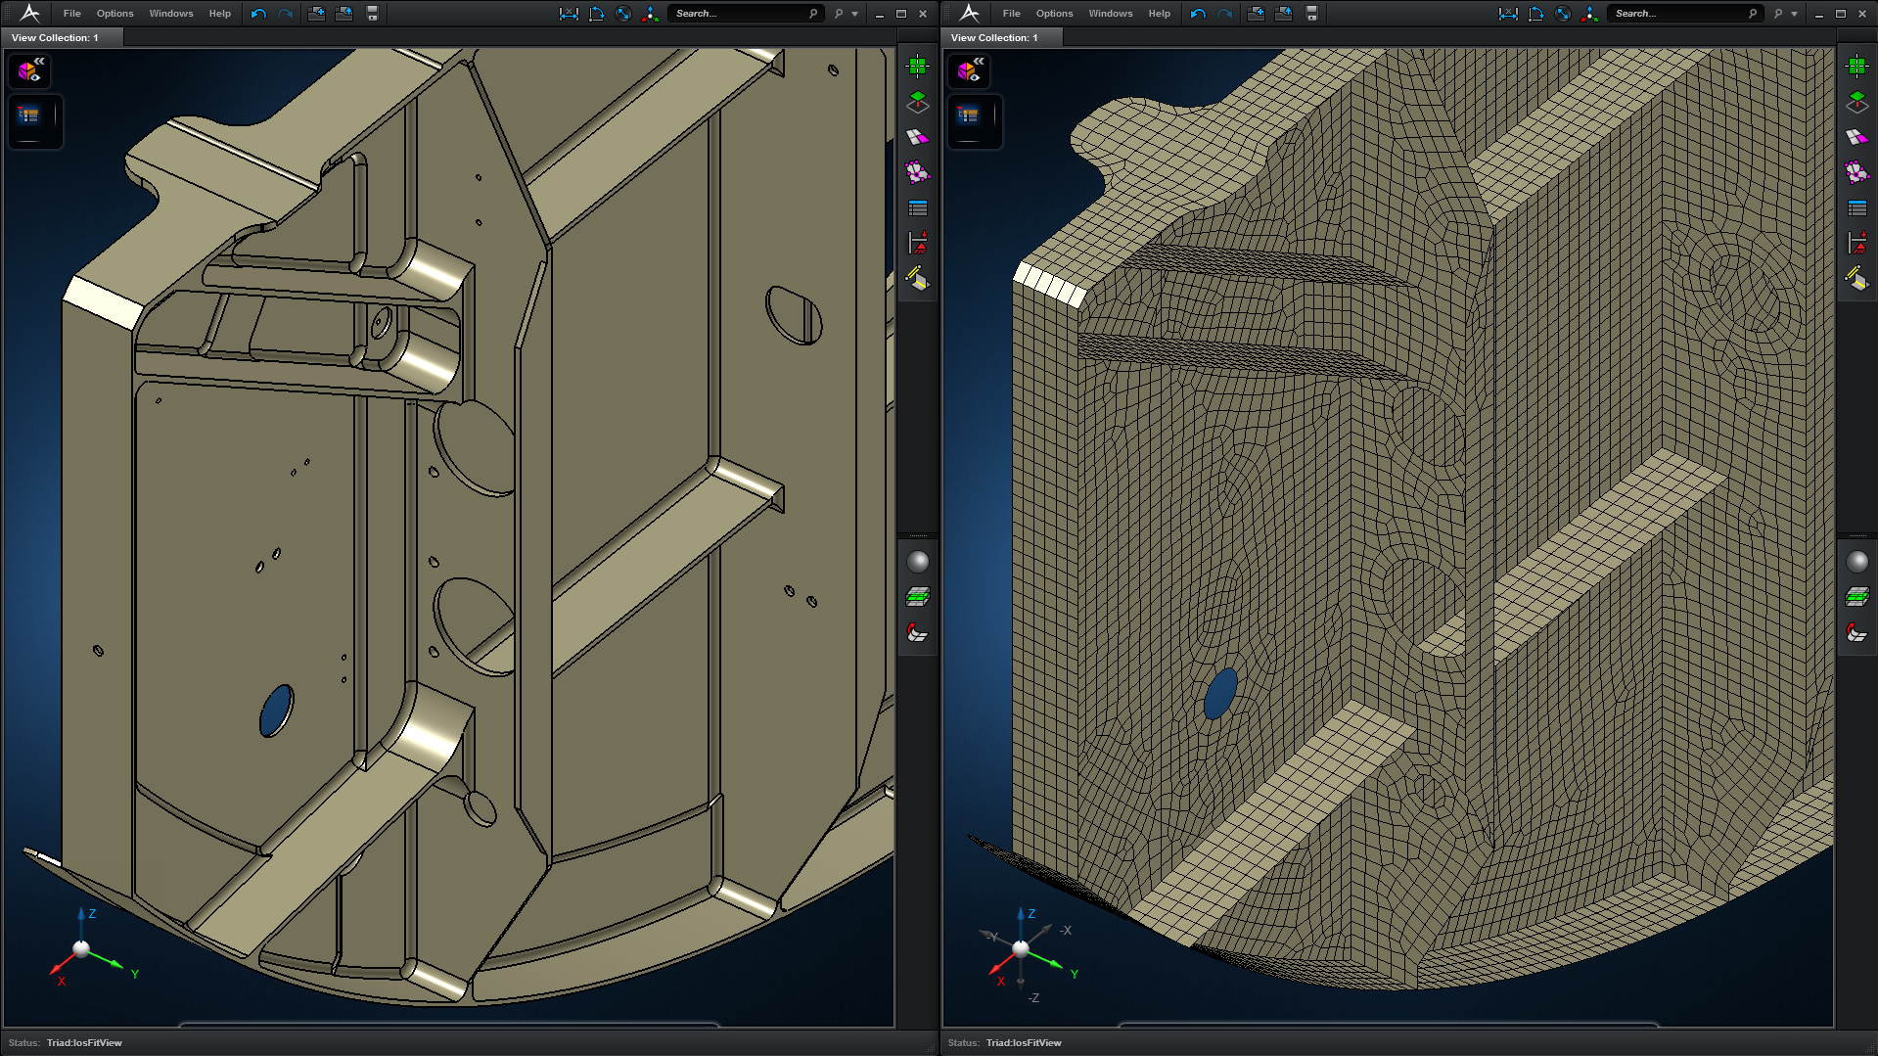
CAD-CAE

Slide 7
For Shapes like Sheet Metal…
 | Solid mesh | Shell+Solid mesh | Difference (%)
Element number | 344,330 | 143,063 | -58%
Node Number | 694,516 | 75,941 | -89%
Total Degrees of freedom | 2,083,548 | 455,646 | -78%
Maximum Von. Mises Stress | 418.4 MPa | 430 MPa | +3%
Meshing + Solving time | Out of memory | 22 mins | N/A (4G RAM)
Meshing + Solving time | 30 mins | 17 mins | -43% (12G RAM)
Half the computation time, but similar accuracy

Slide 8
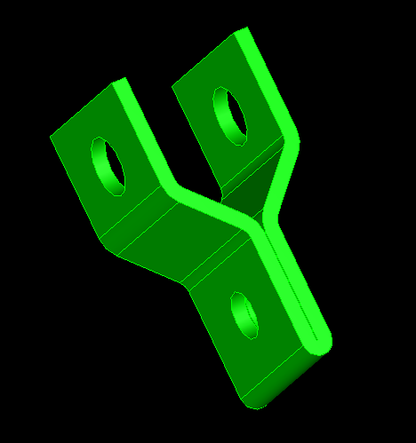
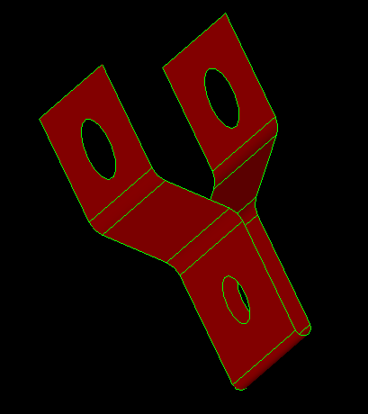
Midsurface is?
Input: Solid
Output: Midsurface
Widely used for CAE of Thin-Walled parts
Computation is challenging and still unsolved

Slide 9
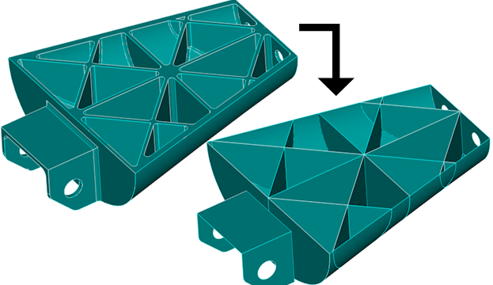
Getting Midsurface
Going on for decades…
Manually by offsetting and stitching, initially
Many CAD-CAE packages give automatic option, but…

Slide 10
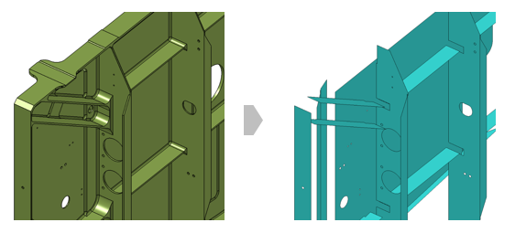
Look at the output

Slide 11
Can’t tolerate gaps
We have thickness sampling,
To recreate/represent the original shape
Input and output difference not desirable

Slide 12
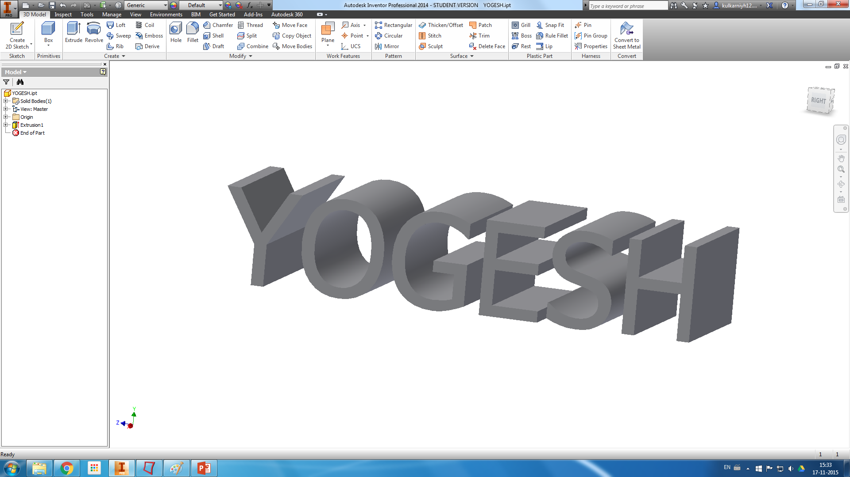
For a simple model like

Slide 13
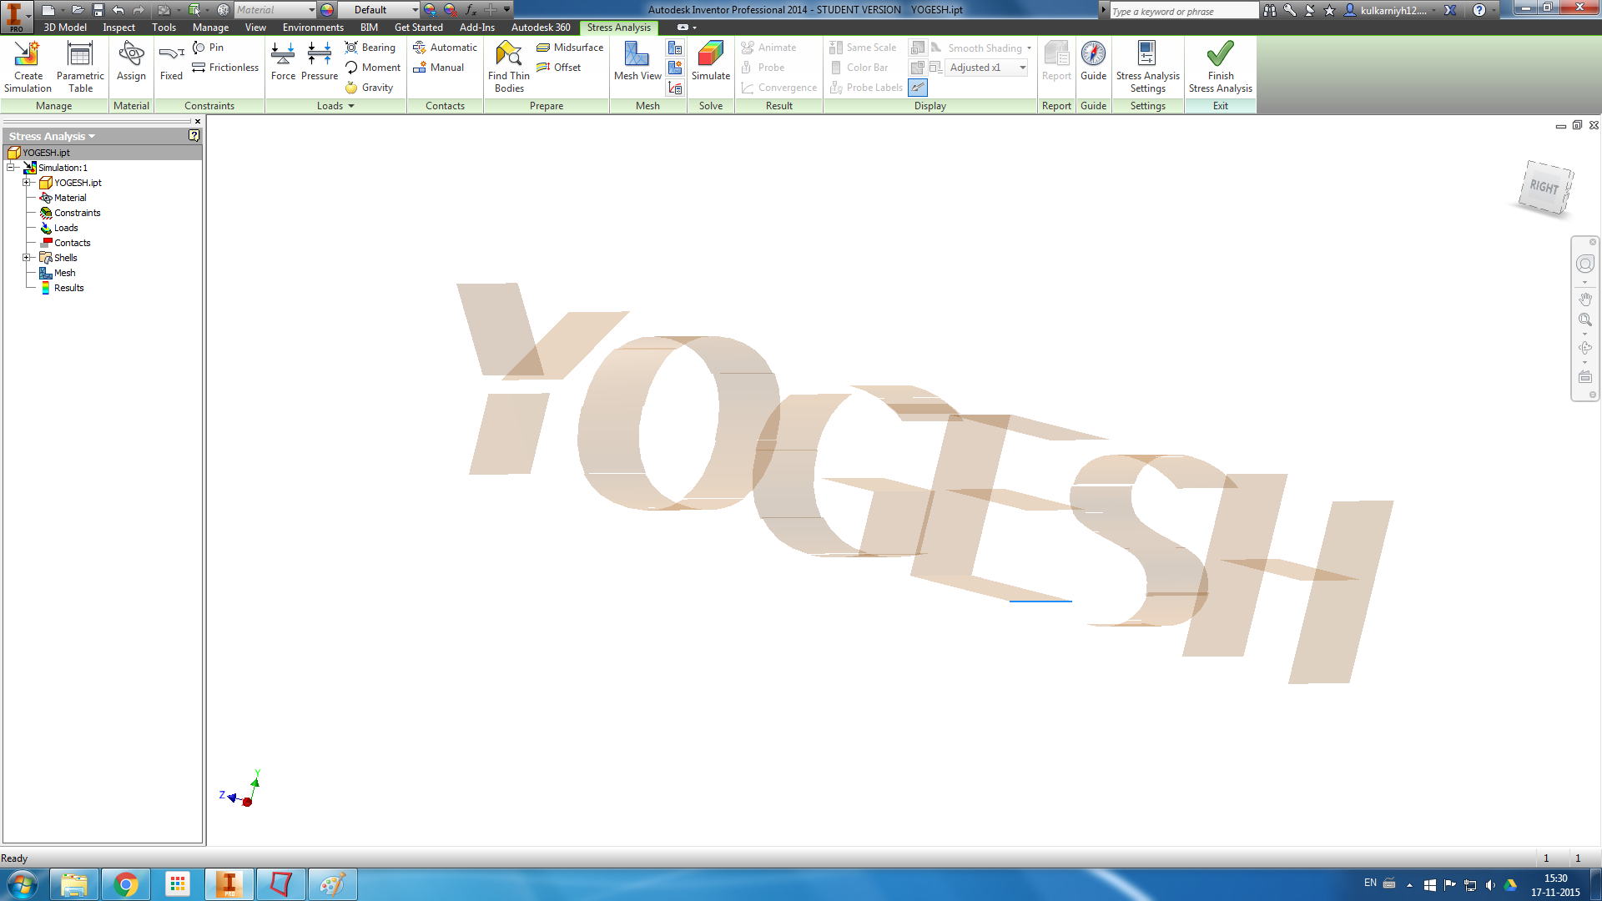
You get

Slide 14
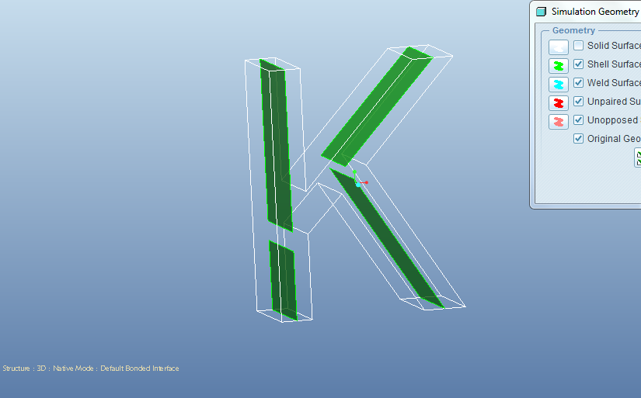
For a far simpler shape

Slide 15
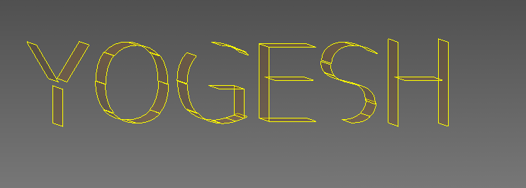
Current Quality
Errors take weeks to correct for complex parts.
But still preferred, due to vast savings time
From Days to hours…

Slide 16
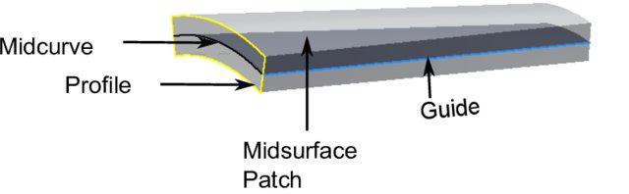
Midsurface Computation
Midsurface of a Patch is Midcurve of its profile extruded.
So, it boils down to computing 1D midcurve of a 2D profile

Slide 17
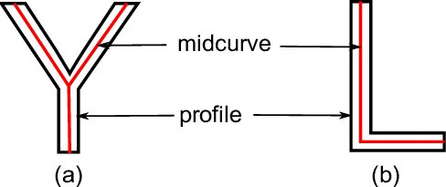
What is a Midcurve?
Midsurface : From 3D thin Solid to 2D Surface
Midcurve : From 2D Profile to 1D Curve

Slide 18
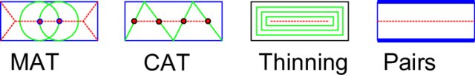
Many Approaches
More than 6 decades of research…
Most CAD-CAE packages…
Rule-based!! Heuristic!! Case-by-case basis!!

Slide 19
When-What
1967 Blum MAT
1994 Dabke Features for Idealization
1996 Armstrong MAT for CAE
2002 Deng FBD Simplification
2005 Stolt Pocket Pad Mids
2007 Robinsn Sketch Mids
2012 Russ FBD defeaturing
1999 Fischer Param Midcrv
1996 Rezayat MA SDRC
2013 Woo Decomp, per feature mids

Slide 20
2017: My PhD Work: Rule-based

Slide 21

Limitations
Fully rule-based
Need to adjust for new shapes
So, not scalable

Slide 22

Idea
Can Neural Networks “learn” the dimension reduction transformation?

Slide 23
How?
Supply lots of training data of profiles and their corresponding midcurves and train.
Then given an unseen profile, can Neural Network compute a midcurve, mimicking the original profile shape?

Slide 24
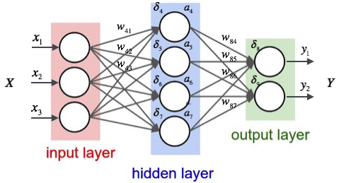
Midcurve by Neural network

Slide 25
Midcurve : The Problem
Goal: Given a 2D closed shape (closed polygon) find its midcurve (polyline, closed or open)
Input: set of points or set of connected lines, non-intersecting, simple, convex, closed polygon
Output: another set of points or set of connected lines, open/branched polygons possible

Slide 26
Midcurve == Dimension Reduction
Like PCA (Principal Component Analysis), wish to find Principal curve
That ‘represents’ the original profile shape

Slide 27
Midcurve == Translation
Left side (input): 2D Sketch Profile
Right Side (output): 1D Midcurve
Sequence 2 Sequence problem

Slide 28
Midcurve != Auto-Encoder Decoder
Its not Auto-Encoder as Input and Output are different
Its not fixed size i/o as Input and Output sizes are different

Slide 29
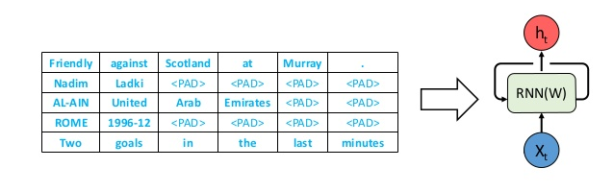
Variable Size Encoder Decoder
Batches need fixed lengths
Made fixed size by Padding.

Slide 30
Variable Size Encoder Decoder
OK for NLP, say Machine Translations, where padding values like “-1” can be added along with other words (vectors or indices)
But in Geometry, its not OK.
Because any value can represent a Valid Input, even though we don’t want it to be the input.

Slide 31
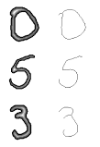
A Twist to the problem
Till we get good variable size encoder decoder network for geometry…
Decided to convert this Sequence 2 Sequence problem as Image 2 Image problem.

Slide 32
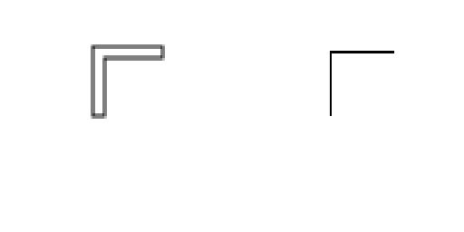
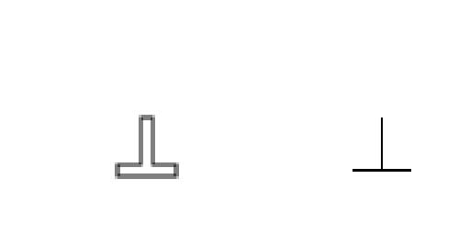
A Twist to the problem
Input: Black & White Image of 2D profile
Output: Black & White Image of 1D midcurve

Slide 33
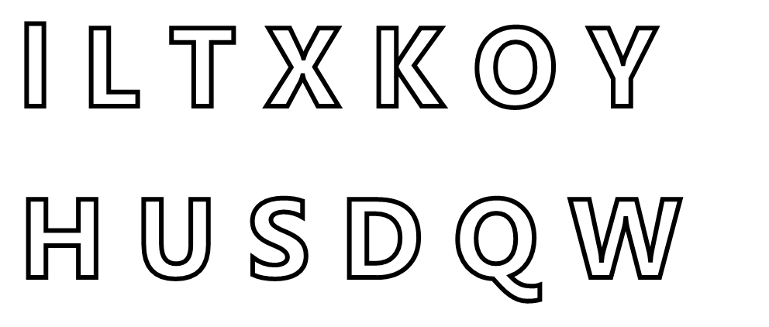
Solves …
Problems of Geometric sequences
Variable input/output sizes
Loops need to be crossed
Branches

Slide 34
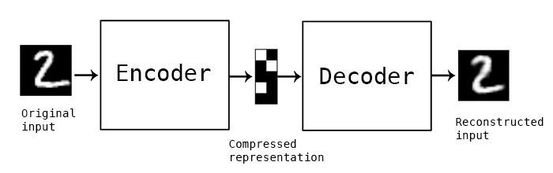
Reuse Image Encoder Decoder

Slide 35
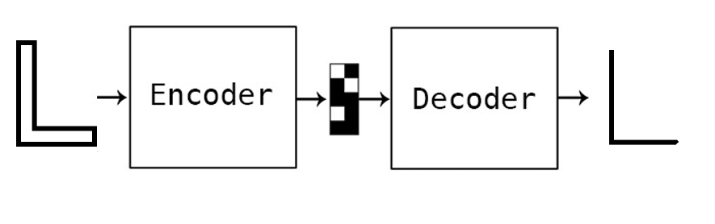
For Dimension Reduction

Slide 36
For Deep Learning
Need lots of data
Had just few input output image pairs
How to augment/populate large variations…

Slide 37
Data preparation

Slide 38
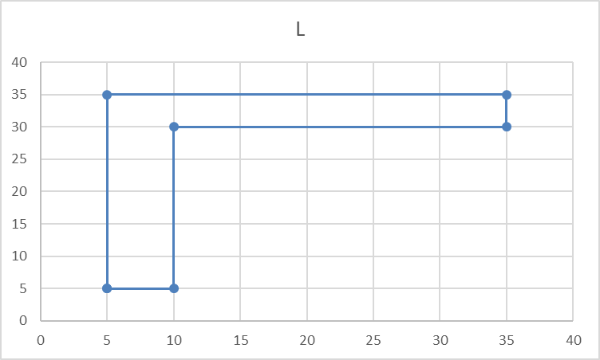
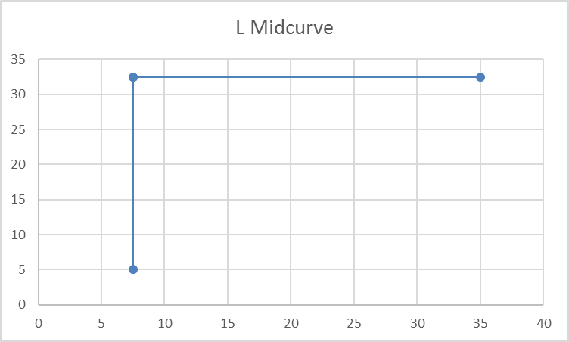
Data
Original input and output are in the form of polylines, meaning a list of points, each having x,y coordinates
Profile Data | Profile Picture | Midcurve Data | Midcurve Picture
5.0 5.0 10.0 5.0 10.0 30.0 35.0 30.0 35.0 35.0 5.0 35.0 |  | 7.5 5.0 7.5 32.5 35.0 32.5 7.5 32.5

Slide 39
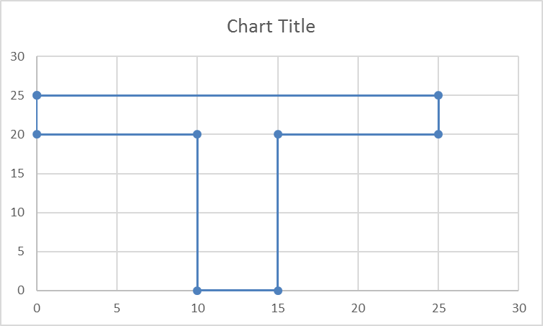
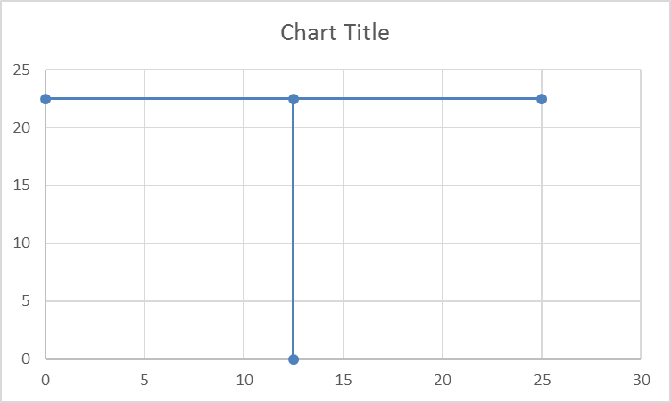
Data
Profile Data | Profile Picture | Midcurve Data | Midcurve Picture
0 25.0 25.0 25.0 25.0 20.0 15.0 20.0 15.0 0 10.0 0 10.0 20.0 0 20.0 |  | 12.5 0 12.5 22.5 25.0 22.5 0 22.5
For each shape, we have this pair of input and output. That’s it.
We need to start with these few samples only

Slide 40
Augmentation
Such few profile shapes, are just not enough for Neural Networks to train.
Need more with as much diversity as possible.
Will need to artificially augment data with transformations, like pan, rotate, mirror, etc.
All needs to be automatically, programmatically

Slide 41
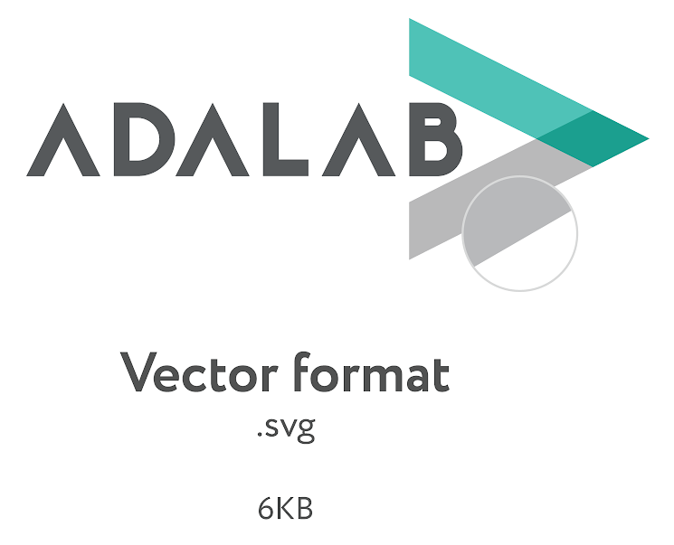

Geometry to Image
Raw input data is in the Vector format
Converted it to fixed size (100x100) image by rasterization of drawSVG library.

Slide 42
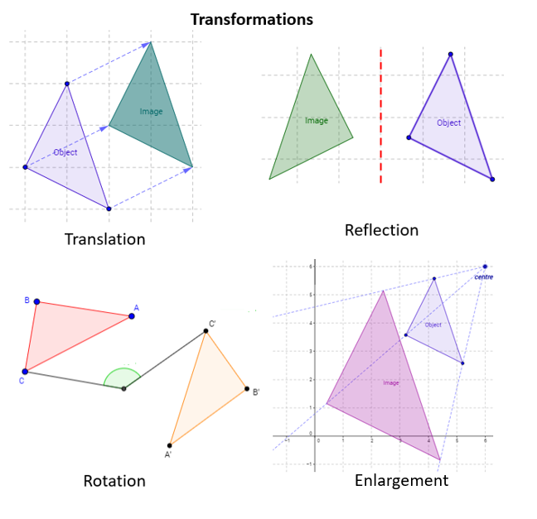
Variations
Inputs: I, L, Plus, T
Operations:
Translated
Rotated
Mirrored
Mirrored Translated
Mirrored Rotated
Total: 896 images (still less, but not bad)

Slide 43
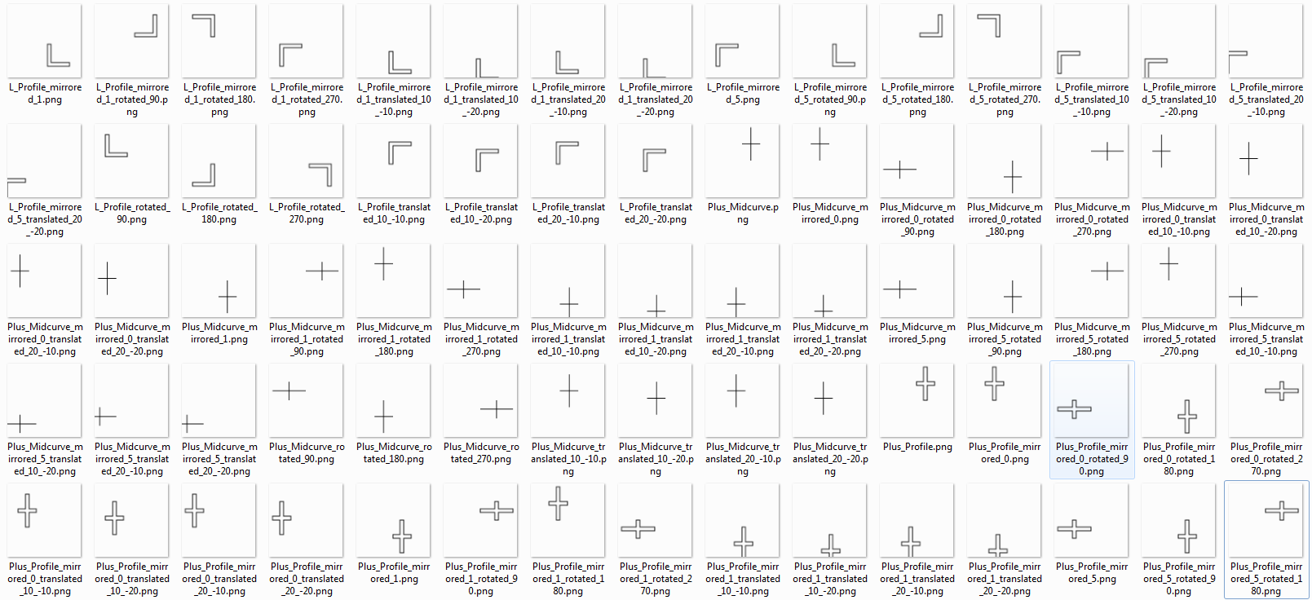
Training Data Samples

Slide 44
Midcurve By neural network

Slide 45
Options For Architectures
Simple Encoder Decoder (one layer each)
Dense Encoder Decoder
Convolutional Encoder Decoder
Pix2Pix
…

Slide 46
Simple Encoder Decoder

Slide 47
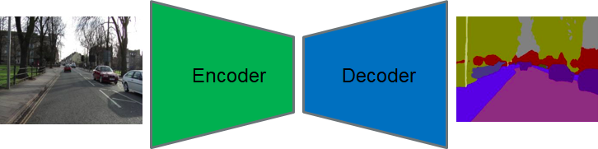
Simple Encoder Decoder

Slide 48
Keras Implementation
input_img = Input(shape=(input_dim,))
encoded = Dense(encoding_dim, activation='relu',activity_regularizer=regularizers.l1(10e-5))(input_img)
decoded = Dense(input_dim, activation='sigmoid')(encoded)
autoencoder = Model(input_img, decoded)
encoder = Model(input_img, encoded)
encoded_input = Input(shape=(encoding_dim,))
decoder_layer = autoencoder.layers[-1]
decoder = Model(encoded_input, decoder_layer(encoded_input))
autoencoder.compile(optimizer='adadelta', loss='binary_crossentropy')

Slide 49
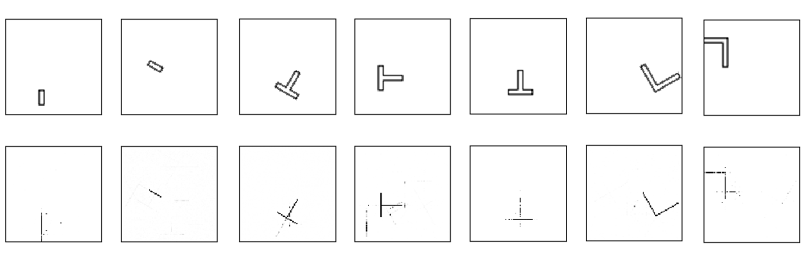
Results

Slide 50
Results
Not very perfect but encouraging
NN is correct with
The location (bounding box)
Dimension Reduction is seen
But, still some stray points and misses

Slide 51
What can be done?
For the noise, use bounding boxes
Feedback into error term: differencing with the known output expected
Classify single pixel image as the skeleton, and rest as noise.

Slide 52
What Next?
Add denoiser network after the current one
More Network Architectures
Sequence-to-Sequence based approaches, taking closed thin polygon as input and polyline as output
Extending to 3D, ie Midsurface

Slide 53
End notes

Slide 54
Summary
Various applications need lower dimensional representation of shapes.
Midcurve is one- dimensional(1D) representation of a two-dimensional (2D) planar shape.
Used in animation, shape matching, retrieval, finite element analysis, etc.

Slide 55
Summary
Approaches: Thinning, Medial Axis Transform (MAT), Chordal Axis Transform (CAT), Straight Skeletons, etc., all of which are rule-based.
Proposing a novel method called MidcurveNN which uses Encoder-Decoder neural network for computing midcurve from images of 2D thin polygons in supervised learning manner.

Slide 56
Summary
This dimension reduction transformation from input 2D thin polygon image to output 1D midcurve image is learnt by the neural network,
Which can then be used to compute midcurve of an unseen 2D thin polygonal shape.

Slide 57
Thank you
yogeshkulkarni@yahoo.com

